Slide 1
On Getting Better at Teaching Writing
Or, why I don’t like Strunk and White

Slide 2
The Elements of Style,
William Strunk and E.B. White (1959)
“It is an old observation that the best writers sometimes disregard the rules of rhetoric. When they do so, however, the reader will usually find in the sentence some compensating merit, attained at the cost of the violation. Unless he is certain of doing as well, he will probably do best to follow the rules. After he has learned, by their guidance, to write plain English adequate for everyday uses, let him look, for the secrets of style, to the study of the masters of literature.”

Slide 3
These are good rules. So what’s the problem?
Make definite assertions. Avoid tame, colorless, hesitating, non-committal language.
avoid a succession of loose sentences
Keep related words together.
In summaries, keep to one tense.

Slide 4
Assumes a “perfect paper” that is out there, rather than building from the ground up
Starts too late in the process
Doesn’t see writing as a form of thinking
Doesn’t see writing as a form of reading

Slide 5
Writing as Thinking
Different kinds of writing – reflections, blog postings, LATTE postings, paper proposals, research questions, “minutes” of class discussions – in addition to more traditional essay assignments
Not all writing is graded
Comments focused on how successfully a piece of writing expresses author’s thinking (argument + motive, flow, the “work” each part of the paper is doing)

Slide 6
Sample “writing as thinking” exercise
[given as part of a research paper assignment, after a preliminary proposal or bibliography is submitted and returned with grades and comments]
Break into pairs
Jot down a one paragraph description of your paper (as you have it developed so far) - include, if you have it, what question you hope to answer, what your argument is, what the motive is, what your evidence is. Don’t worry if you don’t yet have some parts of these. Note that down as well.
Read it aloud to your partner. Your partner will ask questions/make suggestions about each part (question, argument, motive, evidence).
Take notes on your conversation
switch

Slide 7
Writing as Reading
Make a habit of noting and evaluating the way authors put together arguments and motives, and other more and less successful choices they make in their writing.
Once or twice a semester, use the grading rubric used for a given assignment to evaluate a reading selection from the course.
Give out grading rubric in advance, have them use it on their drafts.
Change second short paper assignment to rewrite, without warning

Slide 8
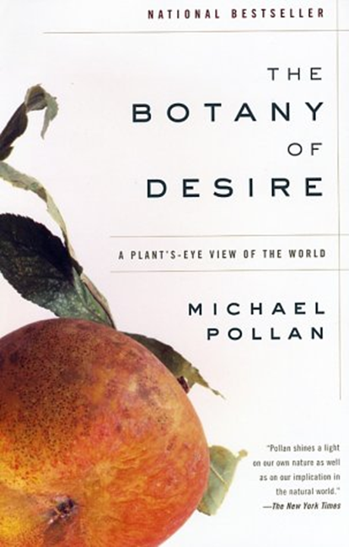
Sample “writing as reading” exercise
read pages xiii-xvi from The Botany of Desire (handout)
What are the argument and motive of the book, based on this excerpt? How persuasive and compelling do they seem?
What evidence will he be using?
How is the section structured? How do the sequencing of the argument and transitions between points work?
How is the writing at the level of the sentence and paragraph? Are there sentences and/or paragraphs that are particularly strong or weak? In what way?

